Slide 1

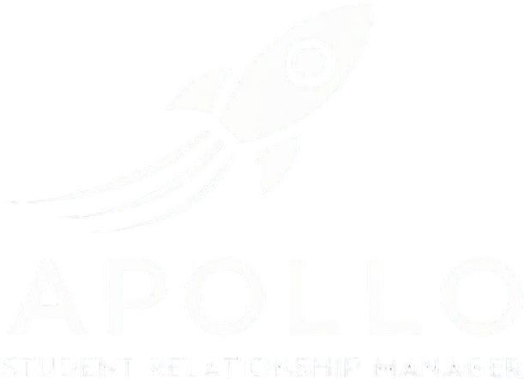

One Platform, Zero Gravity Data
Dock your Student CRM, Applications, and SIS on one mission platform — no risky integrations, no sync drift.
Mission control from first signal to graduation: clearer telemetry, faster course‑corrections, lower burn, happier crews (students + staff).
Launch Benefits (at a glance)
Faster to T‑0 (Decision): Inquiry → application → review → enrollment in real time. No orbital handoffs or nightly batch windows.
Single Source of Ground Truth: One student record end‑to‑end; no duplicate constellations, no mismatched IDs.
Crew Efficiency: Recruiting, Admissions, Registrar, and Finance operate from the same console and checklists.
Student Experience: One portal, one call‑sign, consistent alerts — less friction, higher yield and retention.
Lower Fuel Costs: Retire brittle connectors, API babysitting, and point‑solution licenses.
AI‑Ready Telemetry: Unified data makes dashboards, forecasting, and next‑best‑action guidance reliable.
Compliance & Black‑Box Recording: Full audit trails of every event and adjustment across the flight.
What “All‑in‑One” Delivers in Orbit
1) Unified Flight Plan
Automated campaigns, checklists, document capture, and reminders keep applicants on trajectory.
Decisions instantly update SIS status, schedules, and funding steps — no reentry lag.
2) One Astronaut Record
Demographics, comms, docs, academics, and financials live together in one capsule.
No CSV shuttles or “which system is right?” telemetry debates.
3) Live Mission Dashboards
Pipeline, yield, melt, attendance, SAP, and outcomes in a single view.
Drill from KPIs to the underlying student or activity — not yesterday’s export.
4) Policy Guidance Computer
Configurable rules for prerequisites, packaging, holds, and program changes.
Built‑in audit satisfies accreditors and financial‑aid reviews.
5) Lower Risk, Higher Uptime
No fragile docking adapters (middleware) to maintain.
One vendor to secure, one roadmap to align, one support line to mission control.
Measurable Impact (typical flight data)
+15–30% faster application completion from guided checklists & nudges.
−25–40% staff time spent on reconciliation & duplicate cleanup.
+5–10% higher show‑rate & first‑term retention via unified communications.
−20–35% lower tech spend by retiring connectors and point tools.
Consolidation typically reaches escape velocity on ROI in months, not years.
Why “No Integrations” Is Mission‑Critical
Integrations age and break with every vendor update.
Field mappings and security policies drift over time.
Batch syncs create blind spots that delay action and degrade AI models.
One platform keeps roles, security, and governance coherent and enforceable.
Day‑to‑Day in Mission Control
Recruiters see CRM tasks + app status + holds on one screen.
Admissions decisions trigger SIS updates instantly (program, start date, schedule).
Students receive one flight plan of alerts for to‑dos, class changes, and financial steps.
Leaders track a live funnel through SAP and graduation without spreadsheet EVA.
Systems Map
CRM & Applications Lead capture • omni‑channel comms • checklists • e‑sign docs • reviewer queues • decision letters
SIS Program/catalog • schedules & attendance • grades & SAP • financials & ledgers • transcripts • compliance exports
Analytics & AI Cohort dashboards • yield & melt forecasting • risk scoring • next‑best‑action • audit logs
Rollout Flight Plan
Phased launch (Admissions first, then SIS modules).
Data migration with dedupe & matching rules built in.
Role‑based training and change‑management checklists.
Ready for a Test Flight?
Book a 20‑minute demo to compare your current stack to a unified mission platform — and leave with a tailored ROI model.
ApolloSRM • Logo • Contact • URL
“All-in-One”
Mission Control
Smart. Simple. Seamless.
The Future of Student Relationship Management.
One Platform, Zero Gravity
Dock your Student CRM, Applications, and SIS on one mission platform — no risky integrations, no sync drift. Mission control from first signal to graduation: clearer telemetry, faster course‑corrections, lower burn, happier crews (students + staff).
What “All‑in‑One” Delivers in Orbit
Faster Decisions: Inquiry → application → review → enrollment happens in real time — no handoffs or batch delays.
Trusted Data: One student record end‑to‑end; fewer duplicates, fewer mismatches, fewer surprises.
Operational Clarity: Recruiting, Admissions, Registrar, and Finance share one workspace and one set of checklists.
Better Student Experience: One portal, one login, consistent notifications — more completions, higher yield and retention.
Lower Total Cost: Retire connectors, API maintenance, and redundant point tools.
Analytics & AI Ready: Unified model powers accurate dashboards, forecasting, and next‑best‑action.
Compliance & Audit: Standard policies with full change history.
Why “No Integrations” Is Mission‑Critical
Integrations age and break with every vendor update.
Field mappings and security policies drift over time.
Batch syncs create blind spots that delay action and degrade AI models.
One platform keeps roles, security, and governance coherent and enforceable.
Ready for Launch?
Take one small step for your institution and one giant leap for student success with ApolloSRM. Let's ignite your institutional potential together!
ApolloSRM—guiding your institution from launchpad to orbit, and beyond.

